Slide 2
objectives
Compare the strengths and limitations of three segmentation techniques.
Explore how these segmentation techniques have practical applications.
result 1
result 2
Physics-301/Activity 1 - Color Segmentation.ipynb at main · reneprincipejr/Physics-301 (github.com)
https://drive.google.com/file/d/10yAmcNsyWs8dfkm6fHbPrnsFiF5YHBX9/view?usp=sharing
Notes:
In this activity, we applied blurring kernels of varying orientation and extent sizes, along with increasing degrees of NSR, synthetically, to a test image.
Given the blurred and noisy images, the restoration of the original image was performed by coding the using (1) packaged Weiner estimation via skimage.restoration and (1)estimation using Fourier transforms via numpy.fft in Python. The accuracy of reconstruction, given the blurring parameters, was quantified using the Structure Similarity Index (SSIM).
Lastly, we attempted to estimate the blurring parameters, such as motion direction and pixel extent, of a moving car to super-resolve its quality and decipher the text.

Slide 3
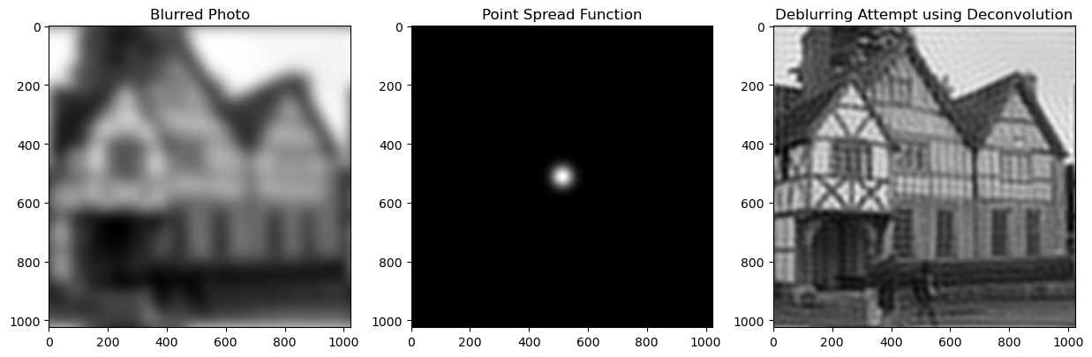
Background
Photo deblurring may seem like magic, but it involves complex physics. Shown below is an image deconvolution technique that leverages a known smearing effect called the point spread function (PSF). The original image appears blurry, as if smeared in all directions. By deciphering the blurred photo's PSF as a Gaussian distribution function, we can apply deconvolution in the Fourier space to reconstruct a much clearer and sharper image. Deblurring using this technique can be valuable in improving low-quality images, with practical applications in identifying faces or letterings from license plates.

Slide 4
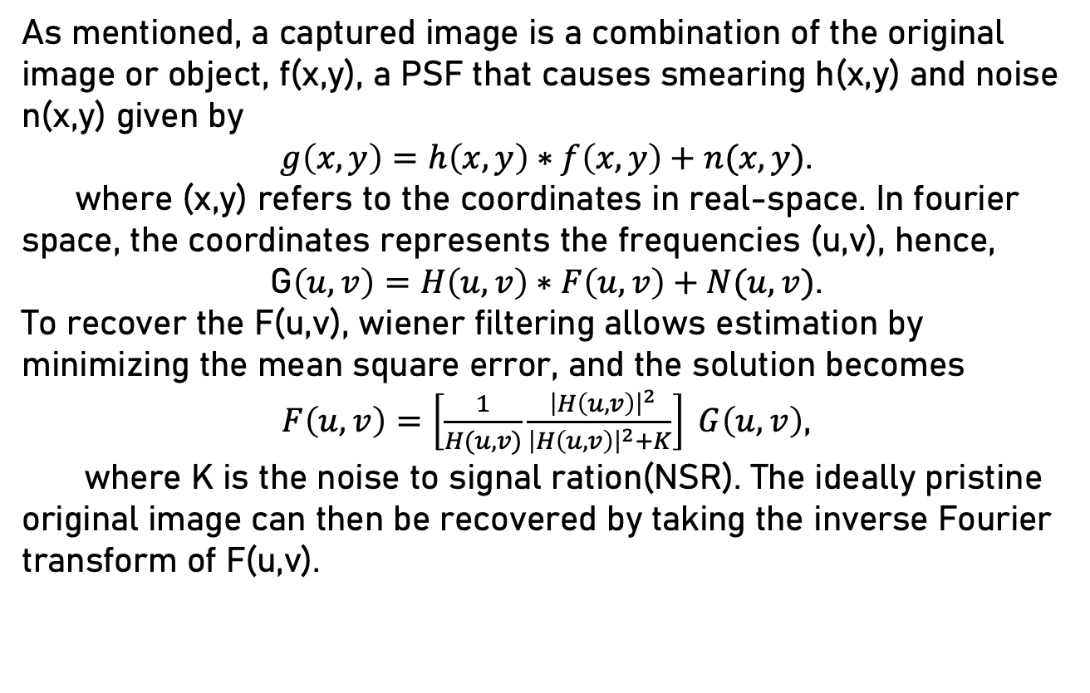
Super-Resolution
As mentioned, a captured image is a combination of the original image or object, f(x,y), a PSF that causes smearing h(x,y) and noise n(x,y) given by
$g\left(x,y\right)=h\left(x,y\right)∗f\left(x,y\right)+n(x,y)$.
where (x,y) refers to the coordinates in real-space. In fourier space, the coordinates represents the frequencies (u,v), hence,
G$\left(u,v\right)=H\left(u,v\right)∗F\left(u,v\right)+N(u,v)$.
To recover the F(u,v), wiener filtering allows estimation by minimizing the mean square error, and the solution becomes
$F\left(u,v\right)=\left[\frac{1}{H(u,v)}\frac{ {\left|H\left(u,v\right)\right|}^{2}}{{\left|H\left(u,v\right)\right|}^{2}+K}\right] G\left(u,v\right)$,
where K is the noise to signal ration(NSR). The ideally pristine original image can then be recovered by taking the inverse Fourier transform of F(u,v).

Slide 5
Method Overview
In this activity, we applied blurring kernels of varying orientation and extent sizes, along with increasing degrees of NSR, synthetically, to a test image.
Given the blurred and noisy images, the restoration of the original image was performed by coding the using (1) packaged Weiner estimation via skimage.restoration and (1)estimation using Fourier transforms via numpy.fft in Python. The accuracy of reconstruction, given the blurring parameters, was quantified using the Structure Similarity Index (SSIM).
Lastly, we attempted to estimate the blurring parameters, such as motion direction and pixel extent, of a moving car to super-resolve its quality and decipher the text.

Slide 6
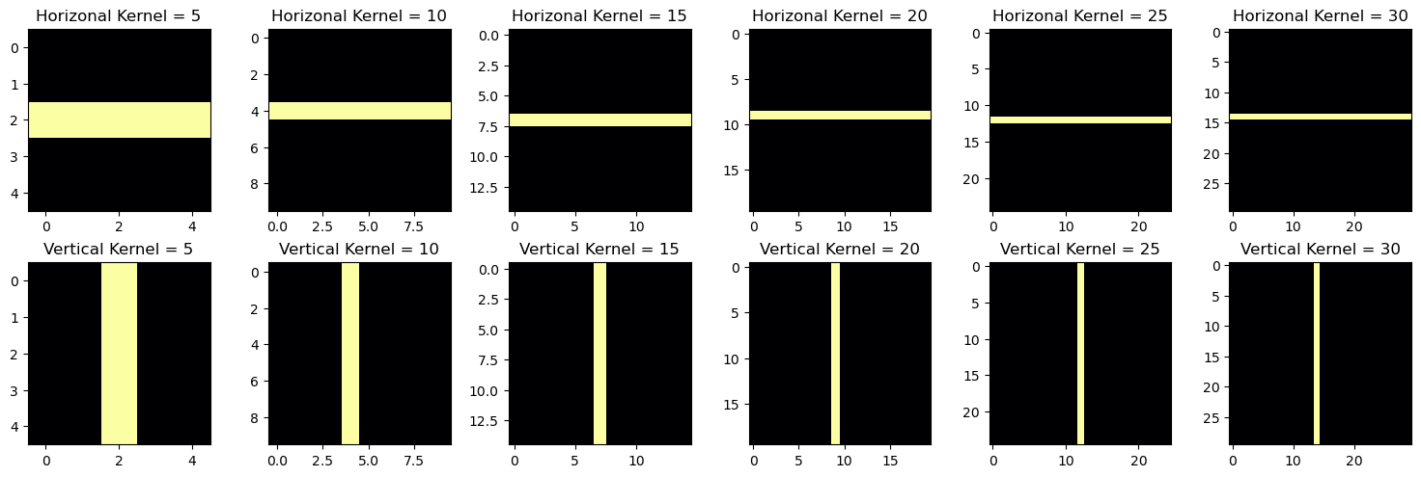
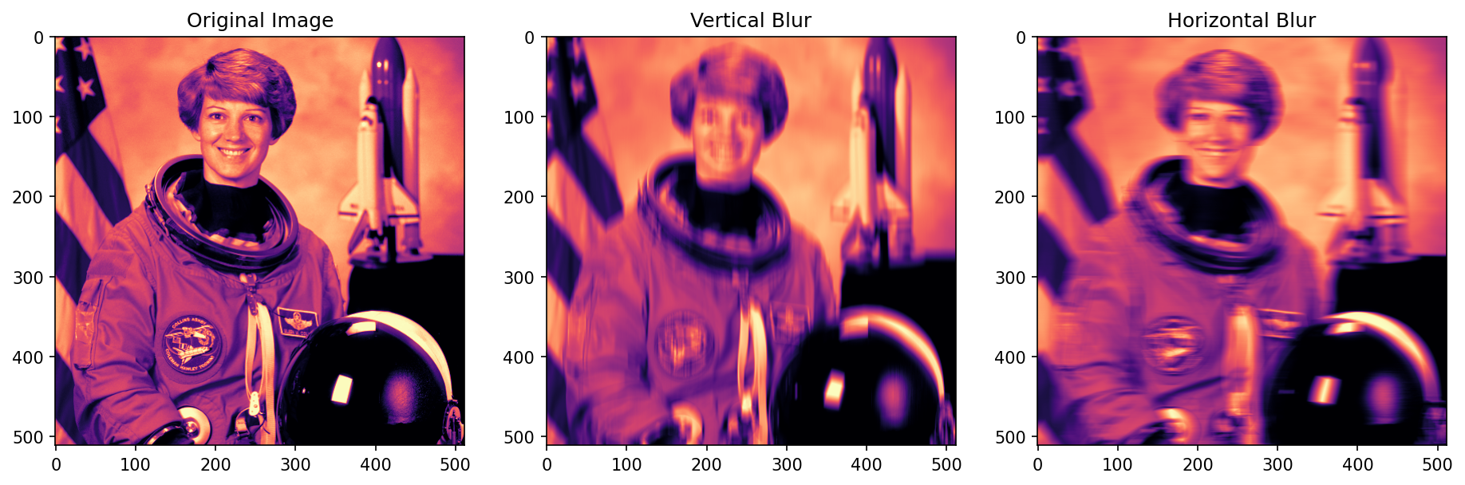
Synthetic kernel blurring

Slide 7
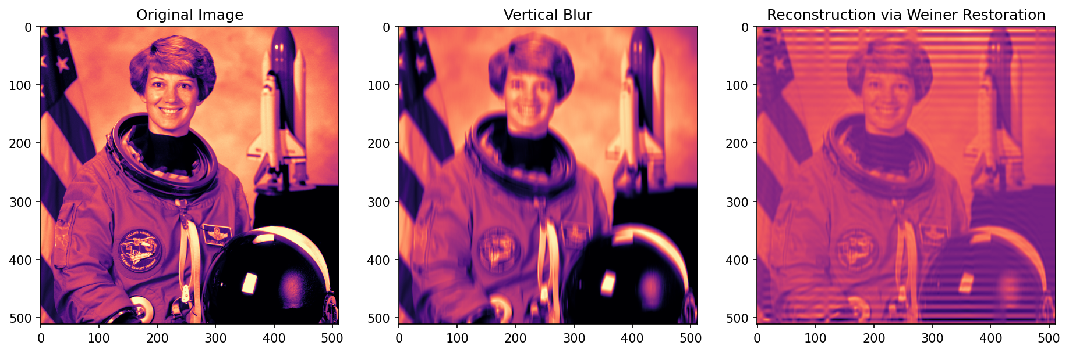
Skimage – Weiner Restoration
After applying synthetic blur, we restored the image using the automated Wiener estimation technique from skimage.restoration. A vertical blur smears the original image upwards and downwards, leading to evident artifacts on the image's extremes. This type of blur also compromises the recovered image's contrast, although the astronaut's face becomes more perceivable and potentially usable for identification.

Slide 8
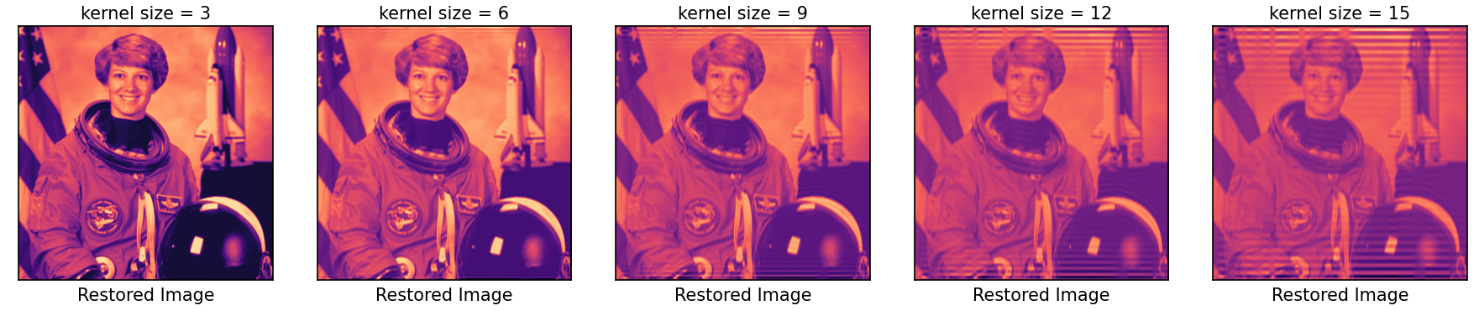
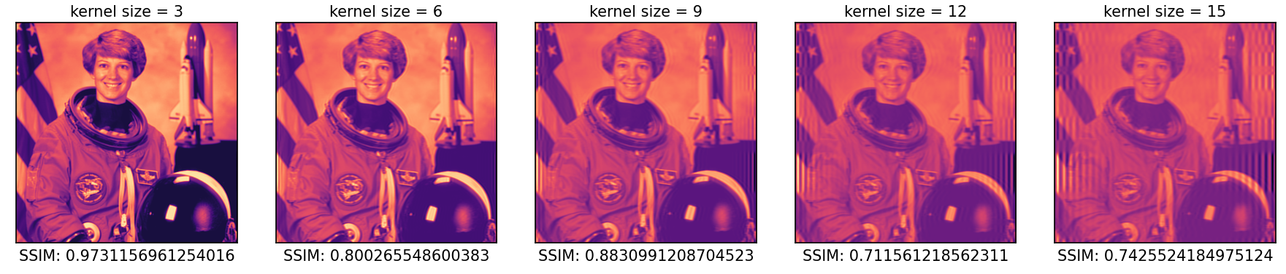
Skimage – Weiner Restoration
By increasing the kernel size for both horizontal and motion blurs, we observed a degradation in restoration quality, with reduced contrast and more prominent artifacts.
Vertical Blurring Kernel
Horizontal Blurring Kernel

Slide 9
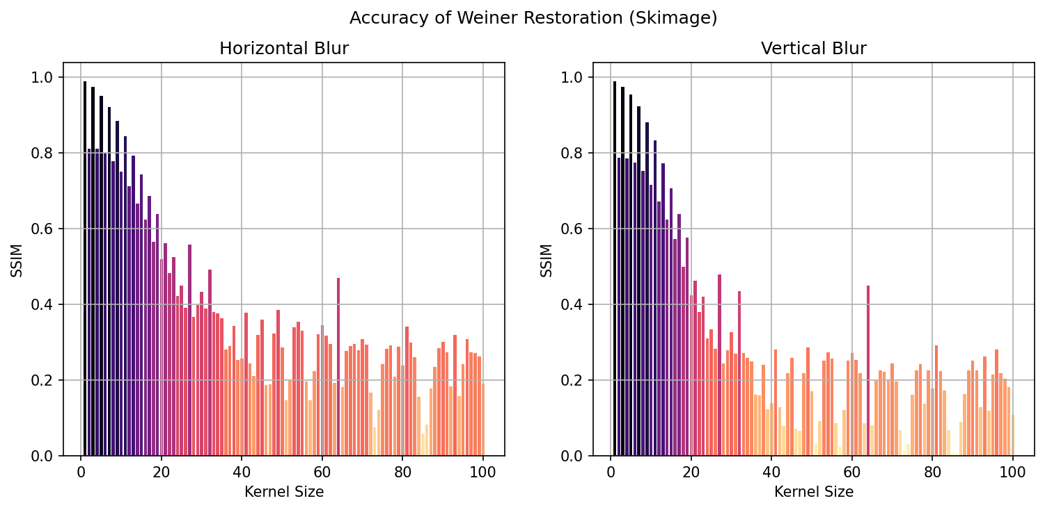
Skimage – Weiner Restoration
Large-scale analysis for small kernel sizes revealed that SSIM fluctuates between odd and even kernel sizes and that vertical blurs tend to degrade the image more than horizontal blur.

Slide 10
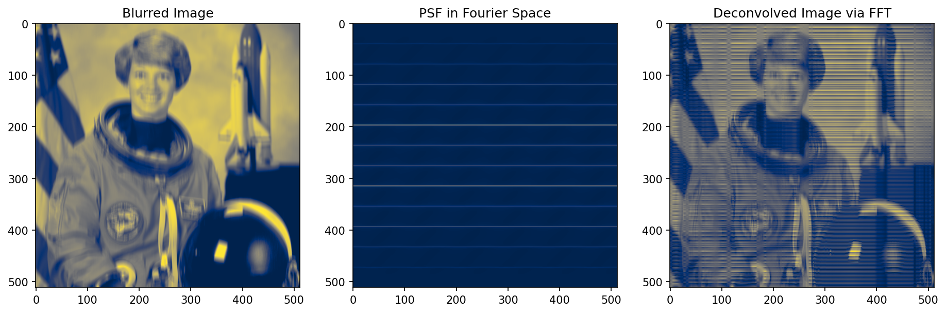
NP.FFT – Weiner Restoration
Since a package was used previously, I implemented the equations for restoration step by step on the fourier space via numpy.fft. Evidenced by FFT reconstruction is the reduction of contrast. The emergence of artifacts was also observed; however, they are more uniformly distributed compared to skimage.restoration. As a result, the face of the astronaut is less perceivable. This observation is true for the horizontal and vertical motion blurs alike.

Slide 11
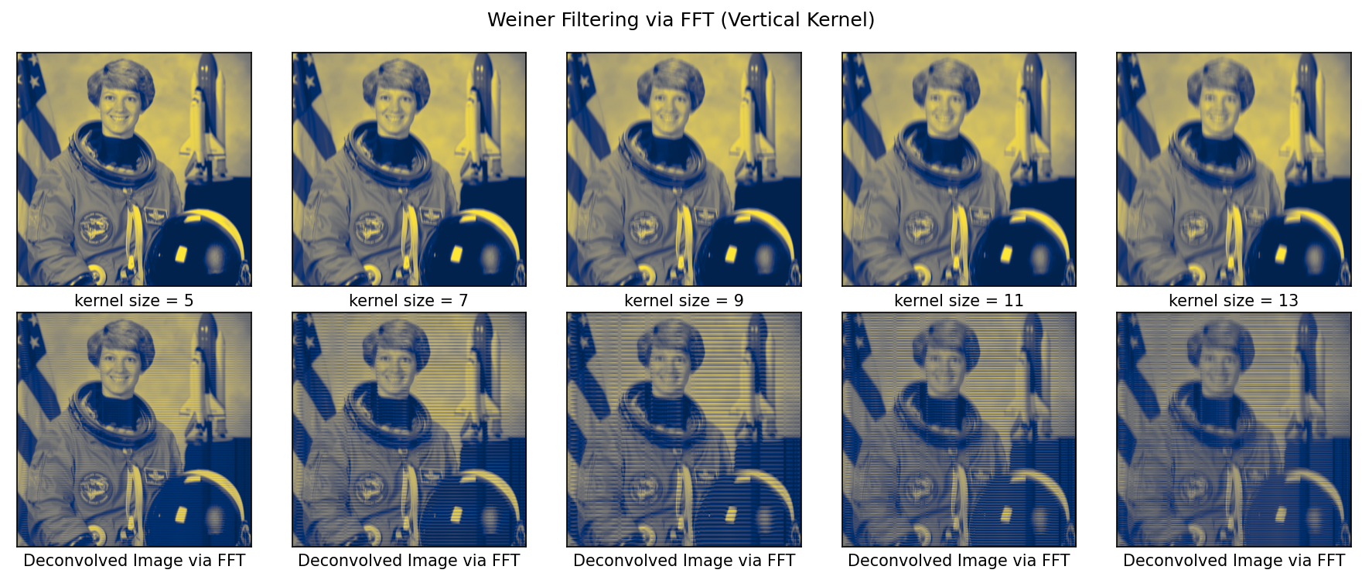
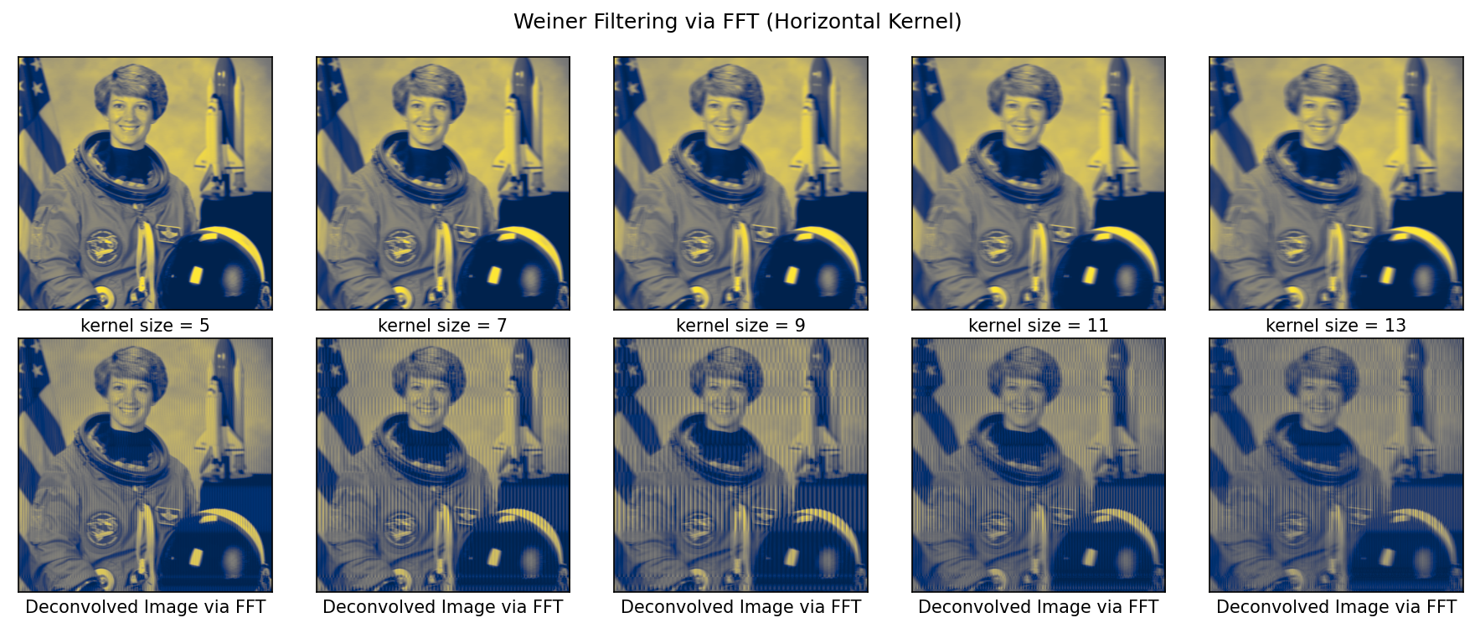

Slide 12
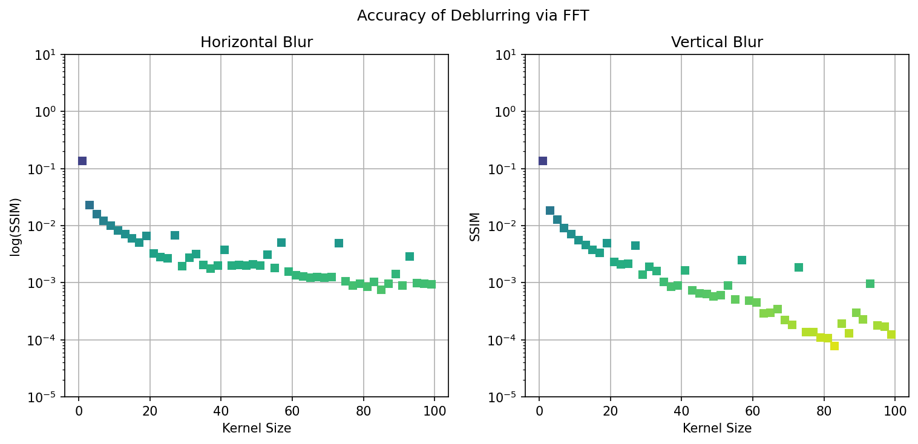
NP.FFT – Weiner Restoration
Large-scale analysis of FFT restoration showed a generally downward trend of SSIM as the kernel size is increased, which means quality is degraded. However, similar to the results using a package, vertical blurs tend to degrade the image more than horizontal blur.

Slide 13
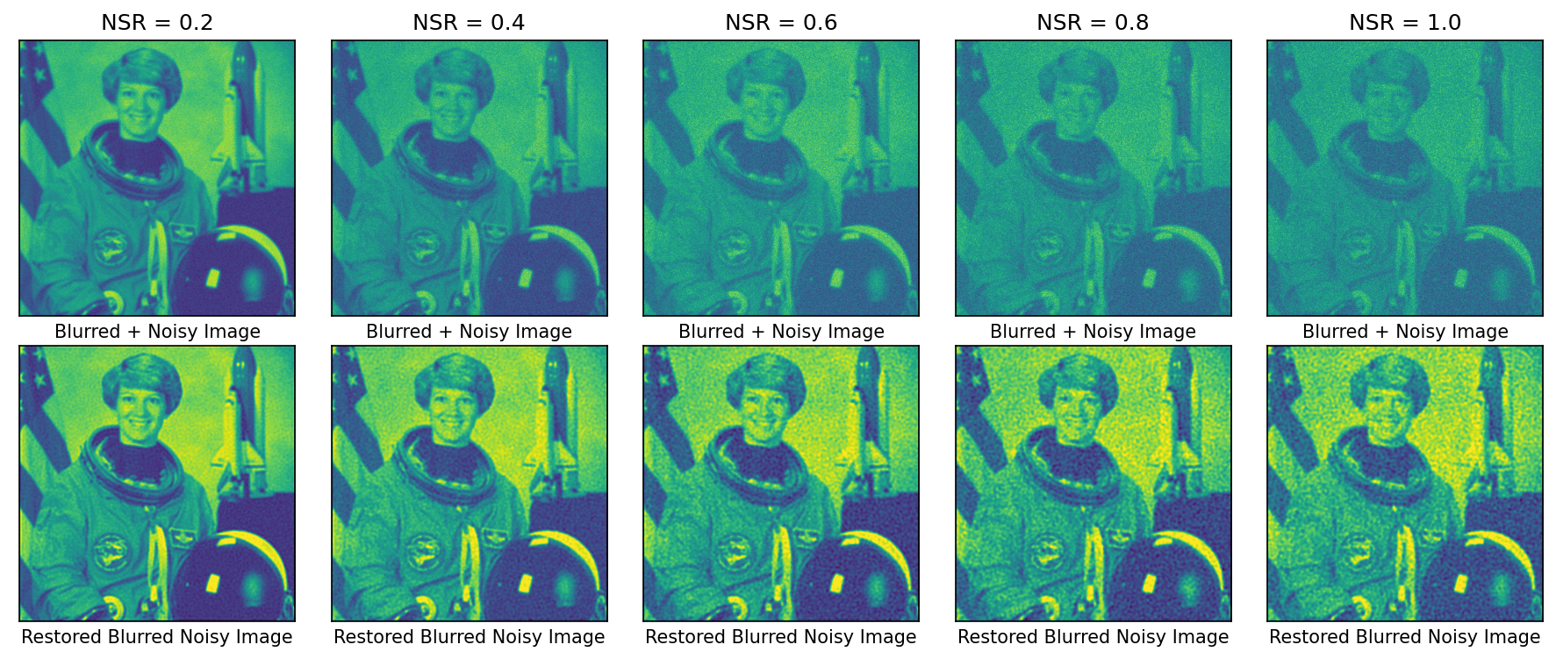
Effects of varying NSR
For a set square blur kernel, the effect of varying NSR was also explored. It was then reconstructed using skimage.restoration. Increasing NSR corresponds to increasing the noise, which reduced the contrast of the original image. Restoration results showed the dominant effect of noise but unlike normal blurring, the contrast remained high.

Slide 14
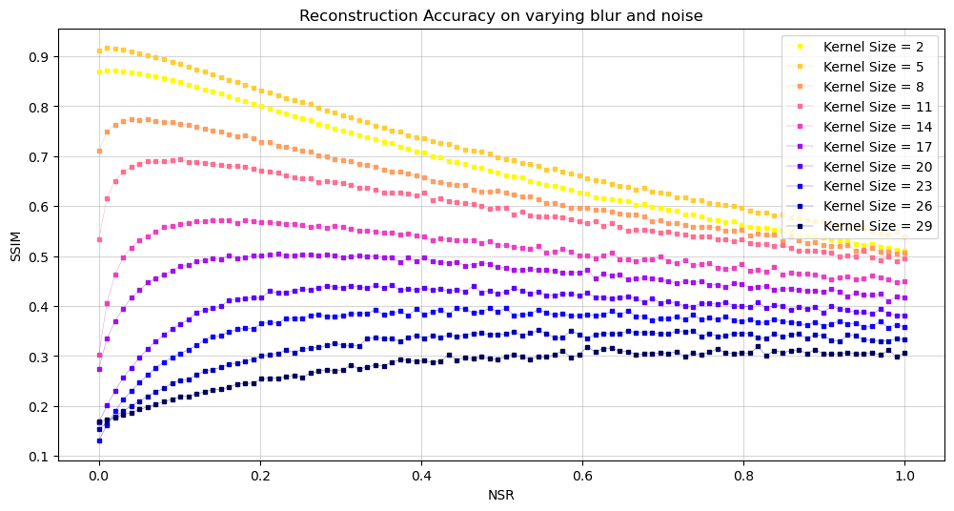
From the blur and noise analysis, the restored image is usable if the motion blur extent is not that drastic, and loss of contrast can be circumvented by adding a sufficient NSR. On increasing kernel size, the restoration is improved by adding a non-zero NSR, until such values that the quality degrades altogether.

Slide 15
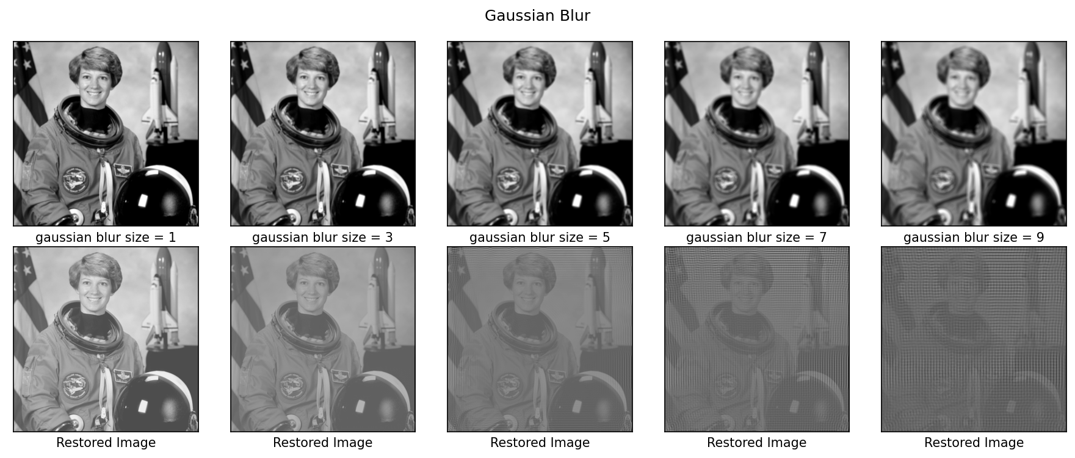
Gaussian Blur
Gaussian blurs drastically degrades the image compared to linear blurs, implying that it might be easier to correct a motion blur than a blur that is a result of an out of focused imaging system.

Slide 16
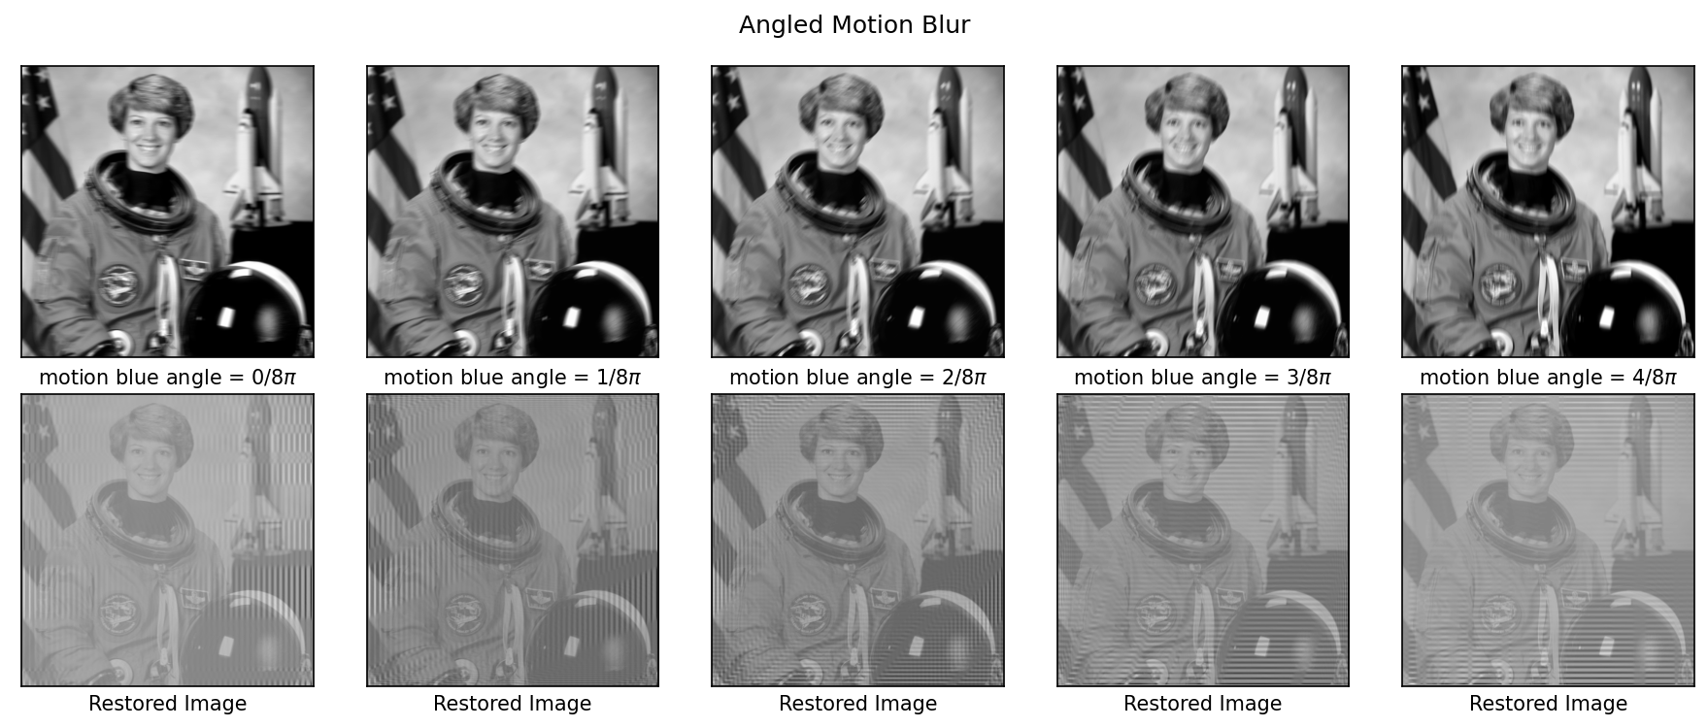
Angular Motion Blur
Meanwhile, angled motion blurs intuitively introduced both horizontal and vertical artifacts.

Slide 17
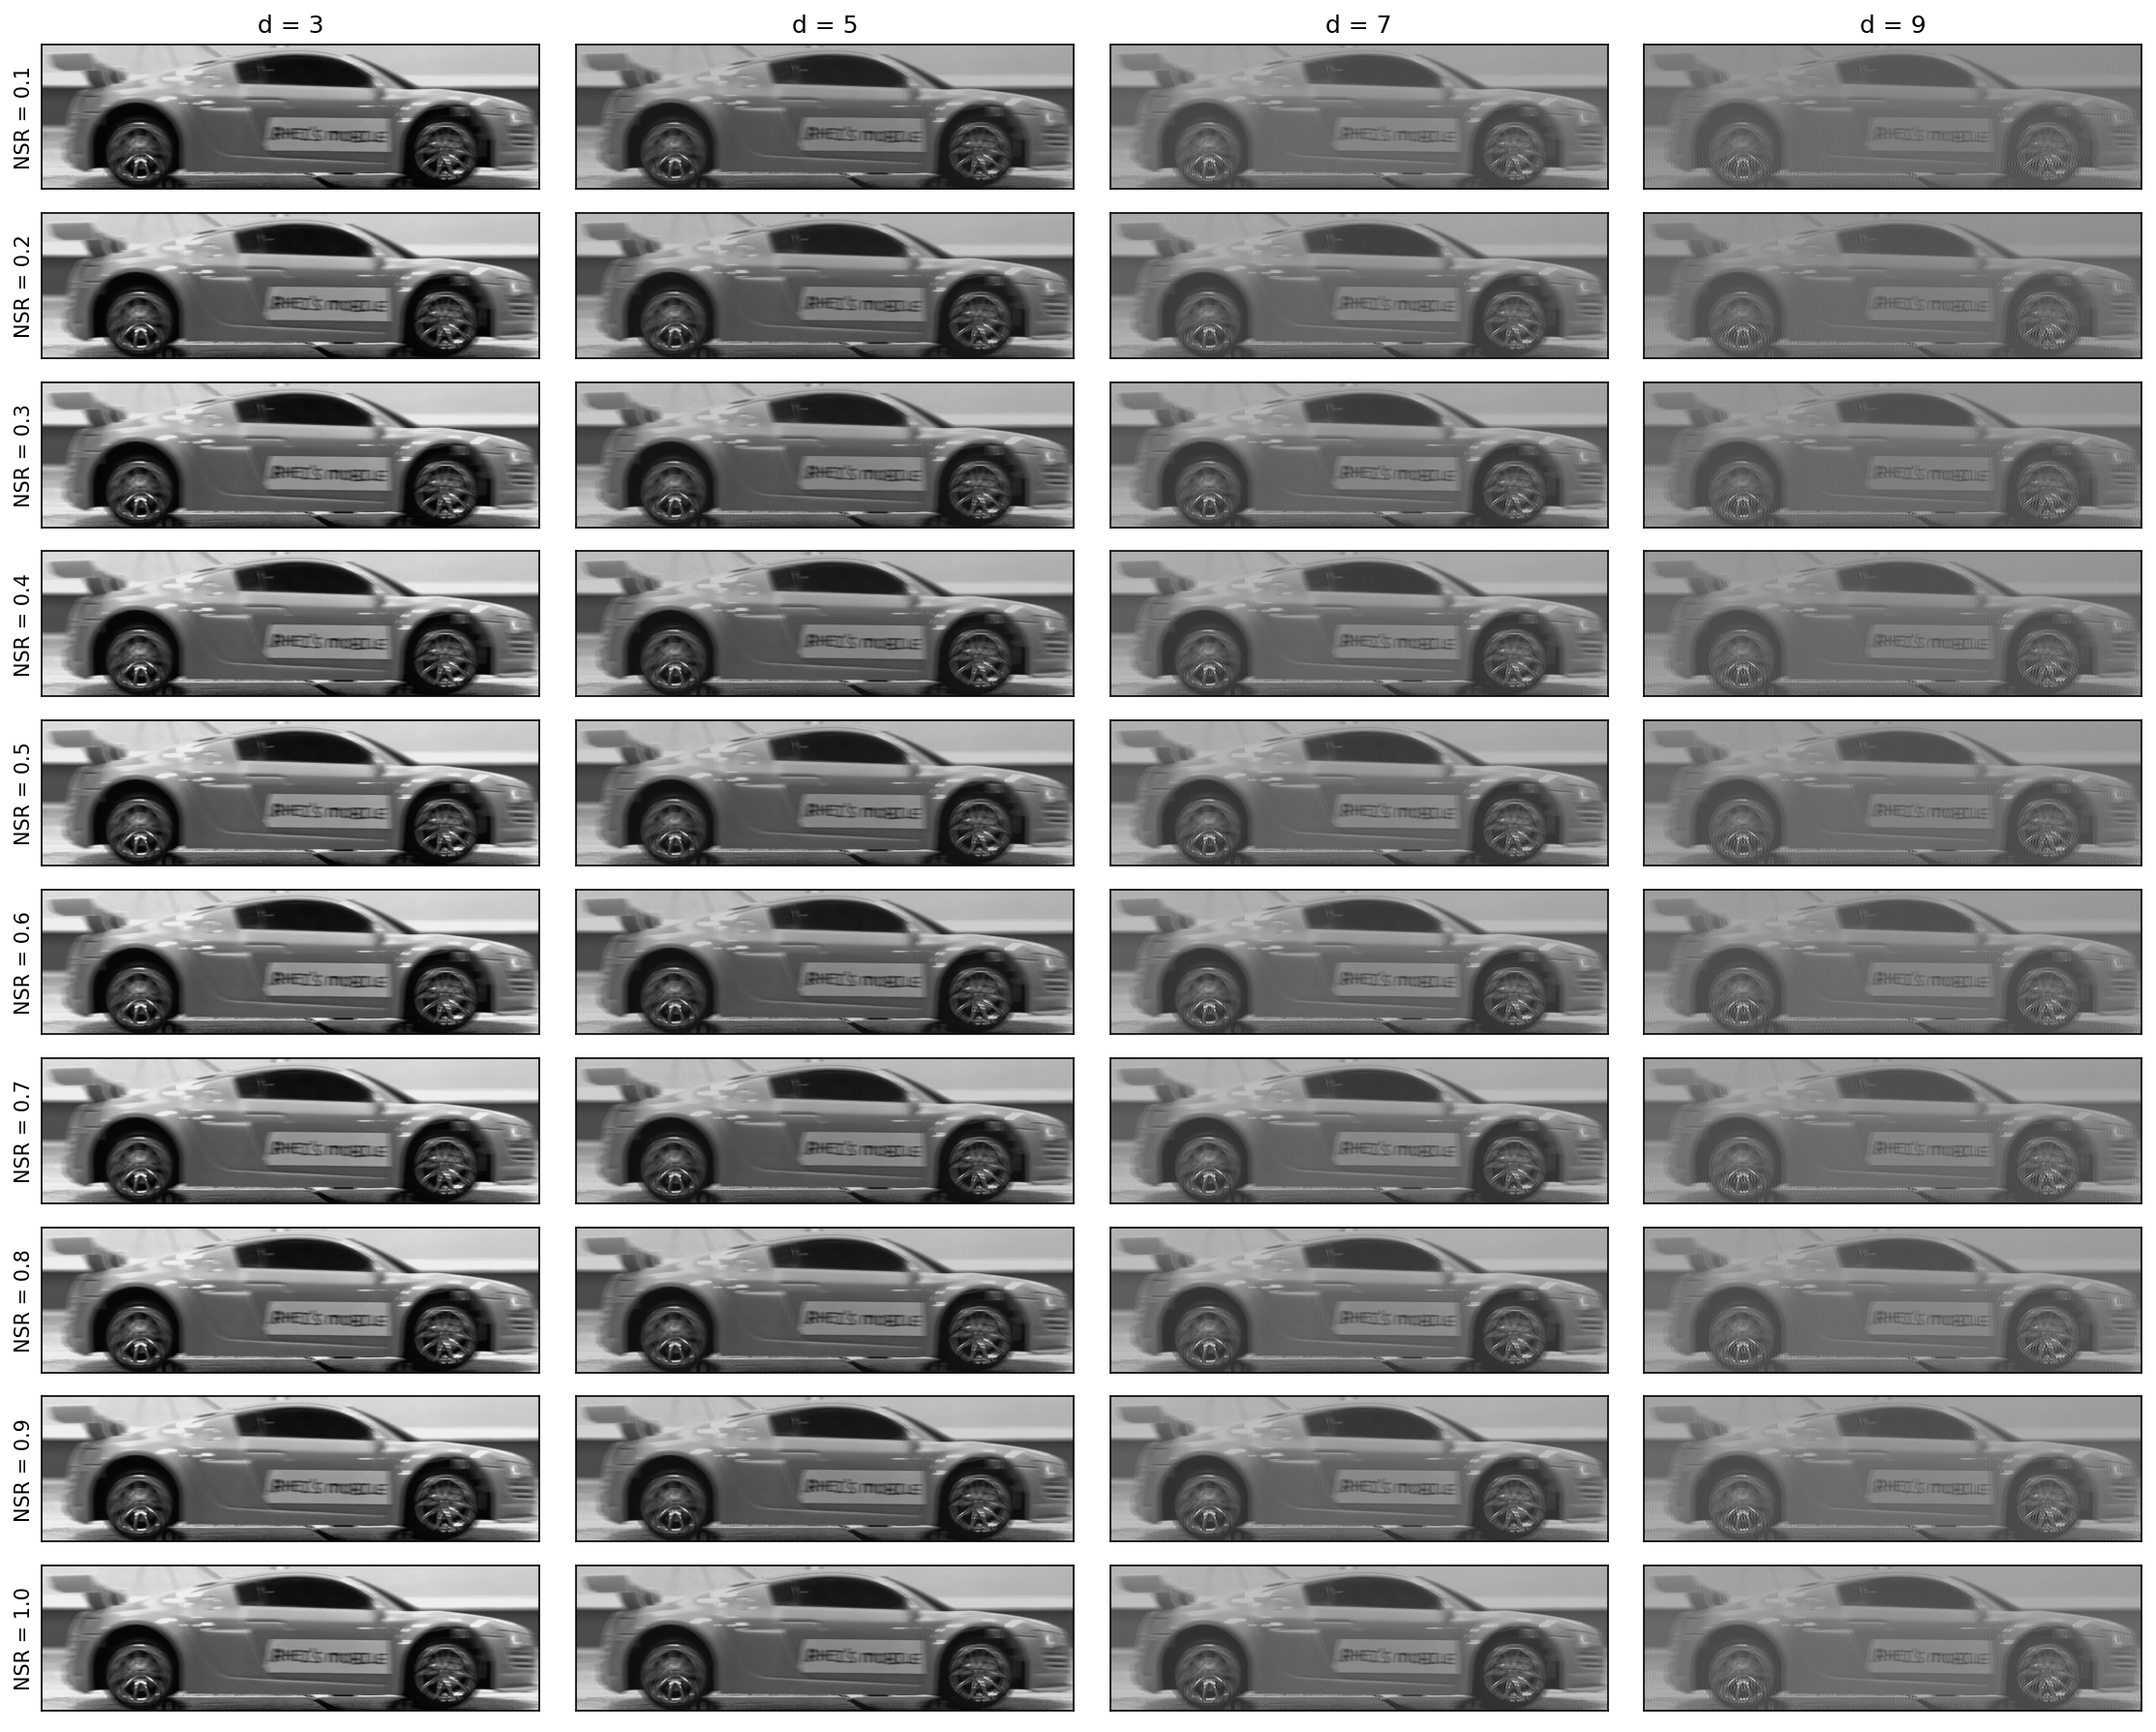
Super-resolving a video frame

Slide 18
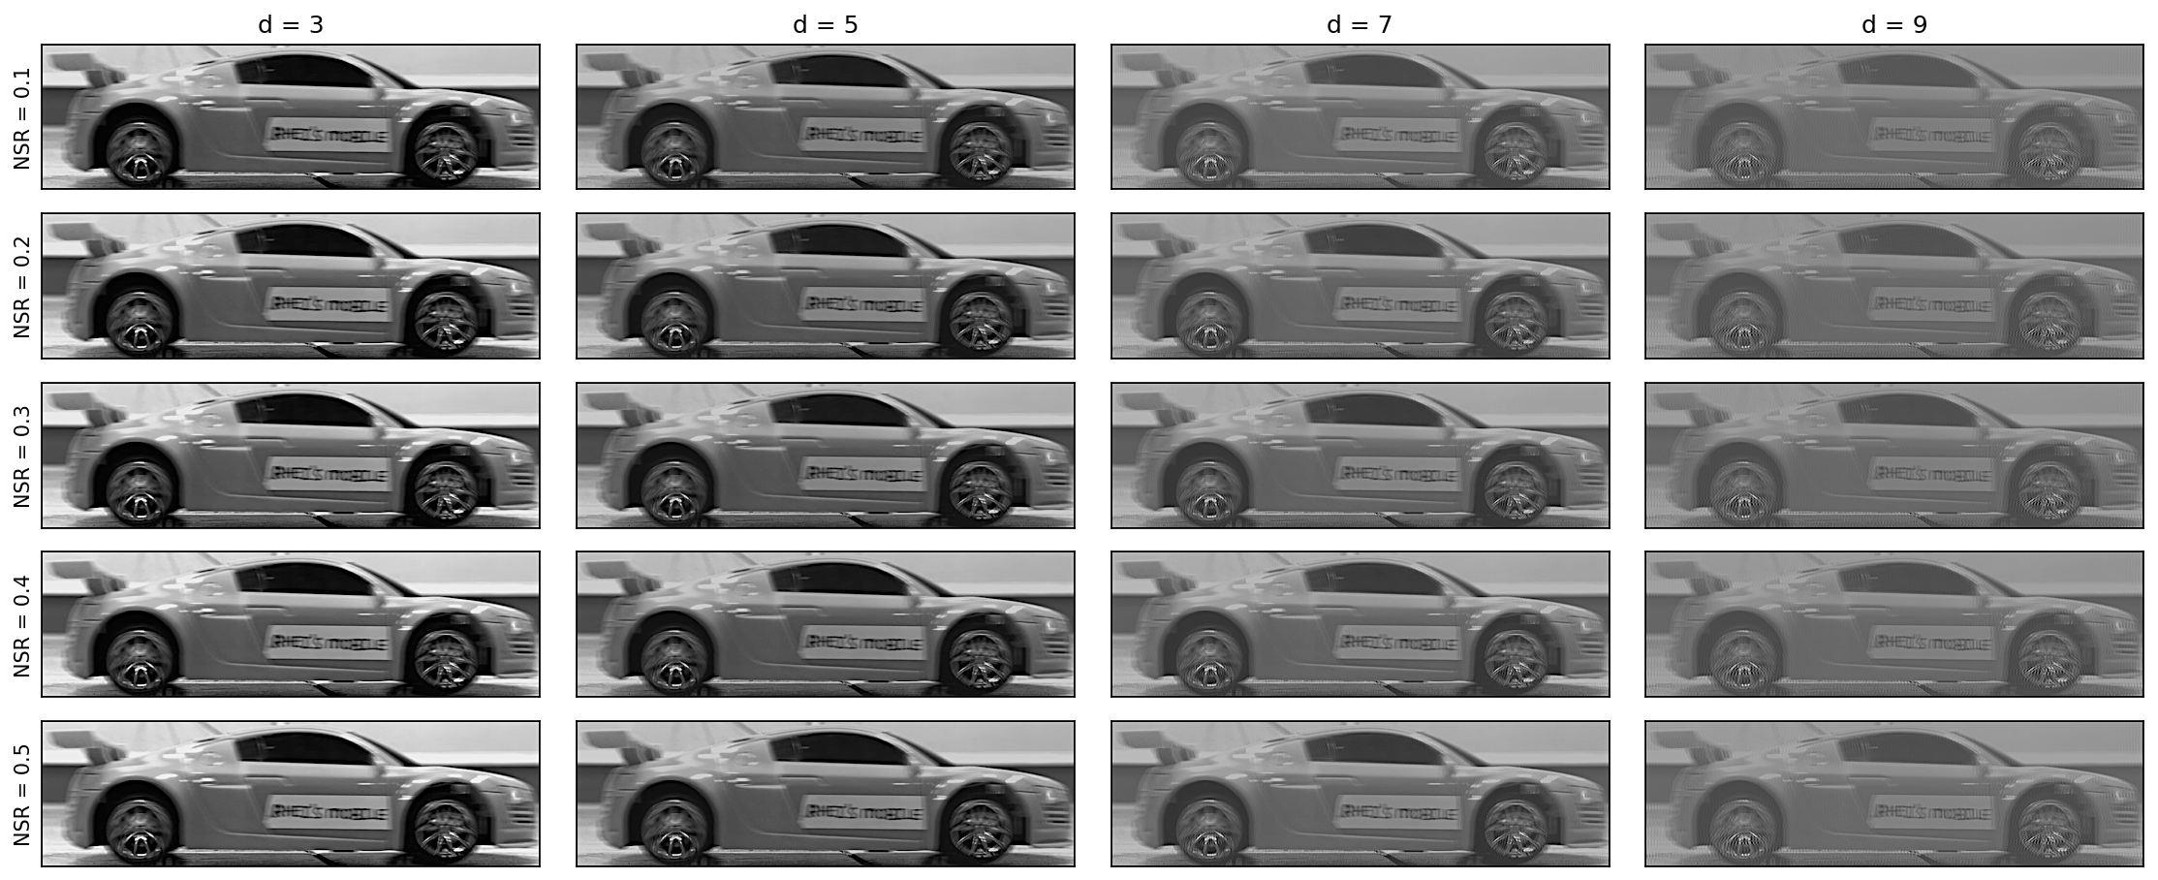
Using a frame from a video of a moving toy car, kernel size d and NSR levels for reconstruction is estimated. As observed, underestimation of the extent of motion blur doesn’t resolve the horizontally blur of the image, while overestimation reduced the contrast, degrading the quality. At d = 7, text becomes more apparent as NSR is increased, further reinforcing the simulation findings. Hence, optimal parameters for kernel extent and NSR should vary depending on the conditions of the captured image.

Slide 19
reflection
I have ventured the realm of spectral super-resolution in my undergraduate thesis and back in my App Physics 155 class, we deconvolved an image using a gaussian PSF. This activity further allowed me to explore the various effects of blurring kernel’s direction and extent, as well as NSR introduction to simulate the the formation of actual captures. I used two methods: hard coding the process and using a package, and believe I was able to deliver a sufficient output. I further explained the large-scale nuances of the parameters in the results by calculating SSIM reconstruction accuracy, revealing interesting findings. The parameter variations in the simulation was also applied on a real-life moving object to deblur it, hence the spatial super-resolution. It was a fun and fulfilling activity.
With that said, I’d give myself a score of 105/100.
[1] M. Soriano, Physics 305 – Super-Resolution Motion Deblurring, (2023).
[2] M. Newman, Computational Physics with Python

